Slide 1
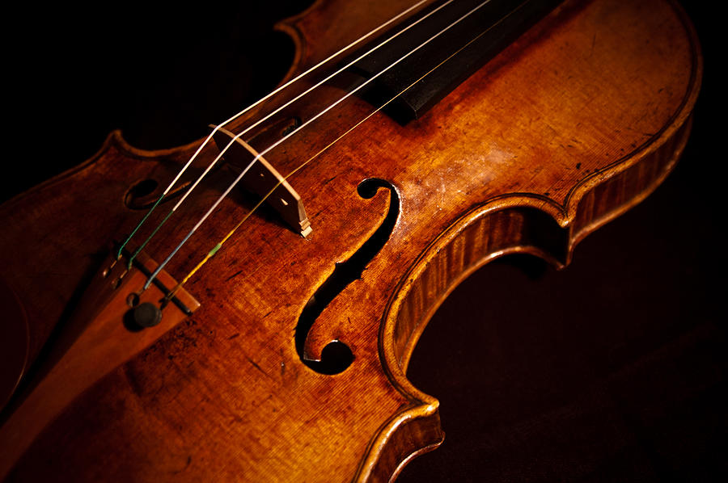
Stringed Instruments

Slide 2
Key Concepts…
Variety of Stringed Instruments:
Plucked, struck, bowed, (shaken not stirred!),…
Standing waves on strings
Wave speed on a vibrating string
Fourier composition of waveform
From vibrating string to audible sound – concept of impedance
Anatomy of a stringed instrument

Slide 3
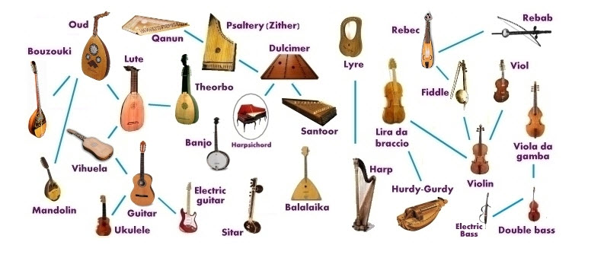

Slide 4
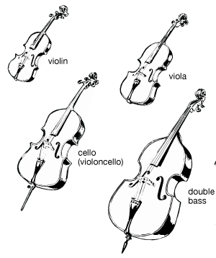
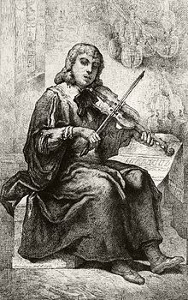
Violin Family
Andrea Guarneri (1626-1698) Cremona
Antonio Stradivari (1644-1737) Cremona
Nicola Amati (1596- 1684) Cremona

Slide 5
Review of Standing Waves…

Slide 6
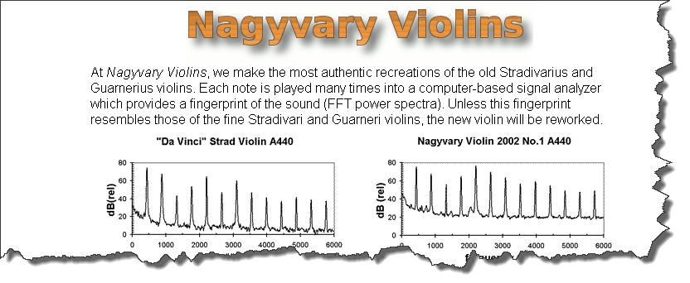
Masters – Old and New…
Which is the Strad?

Slide 7
Parts of a Violin…

Slide 8
The Strings…
Helmholtz – stick/slip process
If “proper” bowing pressure is maintained the stick/slip process is driven by the fundamental mode of the string
Bowing allows a continuous input of energy to the violin

Slide 9
Bowing Speed…
Bowing speed affects how far the string travels during the “stick” phase of motion – hence amplitude of the resulting standing wave A= $v_{b}$ $\frac{(n−1)}{nf}$
A = amplitude, v_{b} = bow speed, f = frequency, n = position
There is a balance between bow pressure and bow speed as well as location wrt bridge

Slide 10
Importance of Impedance…
A measure of opposition to motion of something subjected to a force
Any change in impedance will result in some wave reflection. A wave on a string is reflected strongly if it encounters a barrier having high impedance
The bridge on a violin plays a critical role in transmitting some of the vibrational energy of the string to the body of the violin
Bridge of the violin has just enough impedance (about 1000x that of the string) to let energy slowly transfer from the string to the violin body

Slide 11
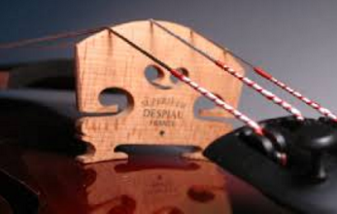
The Bridge…

Slide 12
Visualizing the Vibration of a Violin
Watch this on YouTube

Slide 13
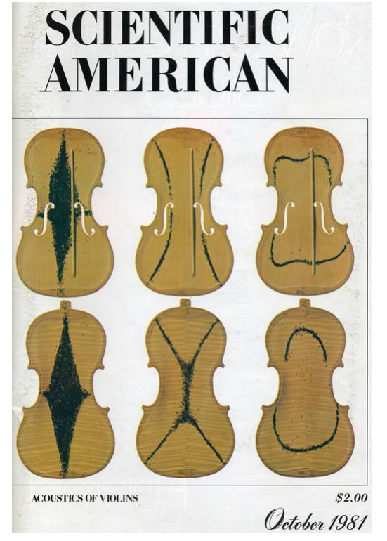
Chladni Patterns on Violin…
The body of the violin oscillates in a complex set of modes
The frequencies of some of these modes should be similar to the fundamentals of the G-D-A-E strings

Slide 14
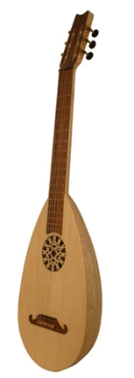
Fretted Instruments…
Guitars, dulcimers,lutes, banjo, mandolin, ukulele…
Guitar frets are positioned between the nut and bridge according to the “rule of 18”
1st fret is 1/18 the distance from nut to bridge, 2nd fret is 1/18th the remaining distance etc…

